Slide 1
GEOGRAPHY
Geography is a field of science devoted to the study of the lands, features, inhabitants, and phenomena of the Earth and planets.
Geography is the study of places and the relationships between people and their environments.
Geographers explore both the physical properties of Earth's surface and the human societies spread across it. ...
Geography seeks to understand where things are found, why they are there, and how they develop and change over time.

Slide 2
THE EARTH AND THE SOLAR SYSTEM THE BIG BANG THEORY
https://youtu.be/GncYOf29uc4

Slide 3
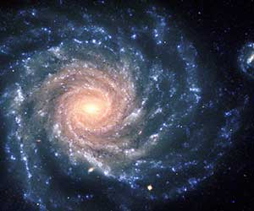
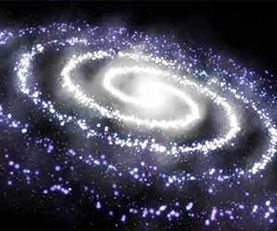
THE EARTH AND THE SOLAR SYSTEM
It is a huge system of billion stars and clouds of dust and gases. Millions of such galaxies make a universe
It is the part of pace with tons and tons of stars crowded together. This crowd of stars looks like the spilled milk and named as a Milky way. Ancient Indians named Milky way as Galaxy.
Earth
It is the fifth largest planet and third nearest to the sun. Its shape is Geoid as it is flattened at the Poles. It gets its light and heat from the sun.
It appears blue from the outer surface as 2/3rd of it is covered by water. It is also known as a blue planet.
It is neither extremely nor extremely cold.
Celestial Bodies
It refers to the sun, the moon and all shiny objects in the sky.
verse. The solar system is the part of Milky way.

Slide 4
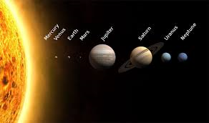
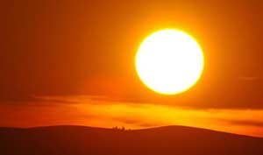
SOLAR SYSTEM
SOLAR SYSTEM
The word Solar system is derived from Roman Mythology where sol refers to the sun and solar is also related to the sun.
The solar system is formed of the sun, Eight Planets, satellites, celestial bodies, asteroids, and meteoroids.
SUN
Sun is the centre of Solar System. It is very huge and made up of gases. The pulling force of the sun binds the entire solar system.

Slide 5
PLANETS
Planets
Planets are the celestial bodies which do not have light or heat of their own. The word planet is originated from a Greek word Planetai which means wonderers.
There are total eight planets in the solar system .All the eight planets (Mercury, Venus, earth, Mars, Jupiter, Saturn, Uranus, and Neptune) moved around the sun in a fixed path called orbits.
Jupiter, Saturn, and Uranus have a ring around them which is made of the belt of small debris.
Mercury is the nearest planet and Neptune is farthest from the sun.
Venus is considered as Earth’s twin as it is similar in shape and size of an Earth
Pluto now is known as a dwarf planet instead of a planet.

Slide 6
FACTS ABOUT SOLAR SYSTEM
Satellites
These are the celestial bodies which move around the planet. Many scientists have designed human-made satellites as an artificial body to gather more information about the universe. Some Indian satellites are INSAT, IRS etc.
The moon
Moon is the natural satellite of the earth. Moon moves around the earth in about 27 days and 8 hours.
Neil Armstrong is the first man to step on the moon.
Asteroids
It refers to the numerous bodies rotating around the sun. They are found between Mars and Jupiter. Scientist believed that it is formed from the explosion of other planets many years ago.
Meteroids
There are small pieces of rocks which move around the sun. Sometimes they are so close to earth that they drop on it. When they drop they appear as a flash of light as they get heated up and burn due to friction.

Slide 7
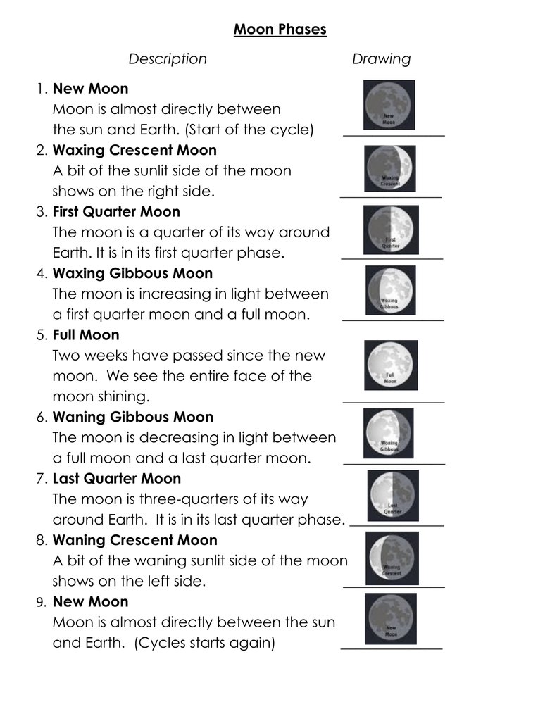
PHASES OF THE MOON

Slide 8
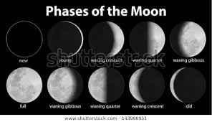

Slide 9
CONSTELLATIONS

Slide 10
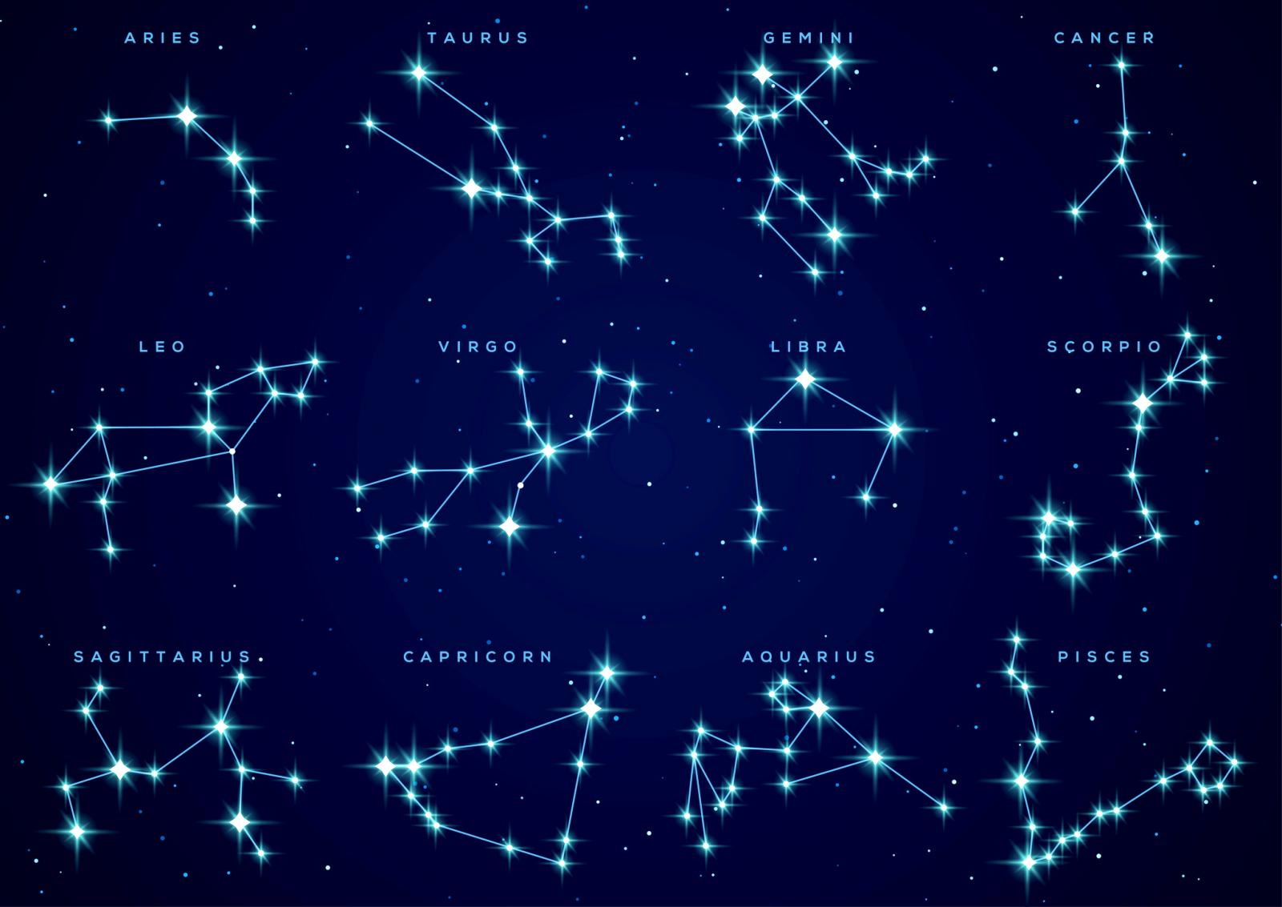
CONSTELLATIONS

Slide 11
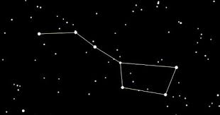
SAPTARISHI
GROUP OF SEVEN STARS

Slide 12
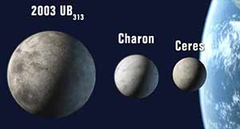
DWARF PLANET
It is the new planet which is recently discovered by Mike Brown in Jan 2005. The planet is called Eris and its formal name is Xena.
It is bigger than Pluto and farther from the sun.
It is the largest Dwarf Planet.
It is the ninth largest body known to orbit the sun.

Slide 13
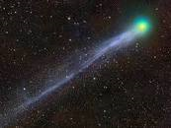
COMETS
Comets are basically dusty snowballs which orbit the Sun. They are made of ices, such as water, carbon dioxide, ammonia and methane, mixed with dust.

Slide 14
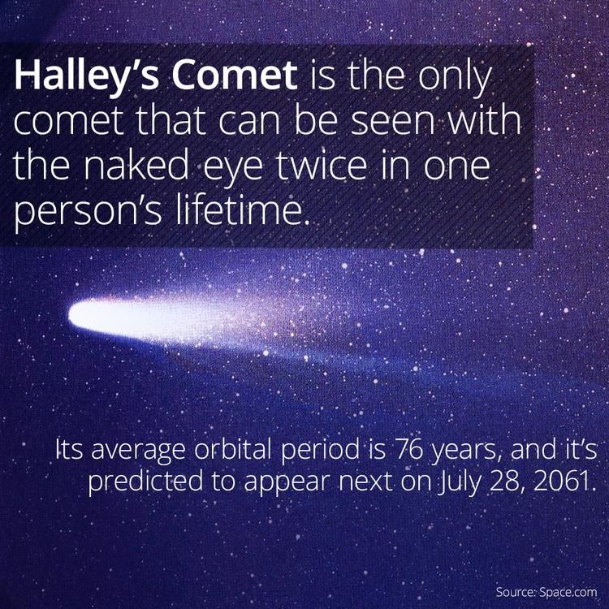
HALLEY’S COMET

Slide 15
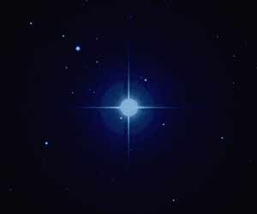
POLE STAR
POLE STAR INDICATES THE NORTH
LOCATING THE POSITION OF THE POLE STAR WITH THE HELP OF SAPTARISHI

